Slide 1
Tips in Design Pattern OOP Coding
Yoobee Colleges

Slide 2
Agenda
2
When we should use design pattern to solve problems
Practical examples with the use of design pattern

Slide 3

When we should use design pattern

Slide 4

When to Use Design Patterns:
1. Object Creation Complexity - When you need to create different types of objects based on conditions
2. Tight Coupling - When your code directly depends on specific classes, making it hard to change
3. Repetitive Code - When you're duplicating object creation logic across your application
4. Future Extensibility - When you need to easily add new types without modifying existing code.

Slide 5
Practical Example: Database Connection Management
Database Connection Management

Slide 6
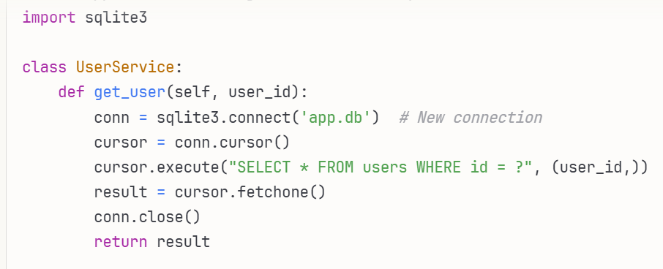
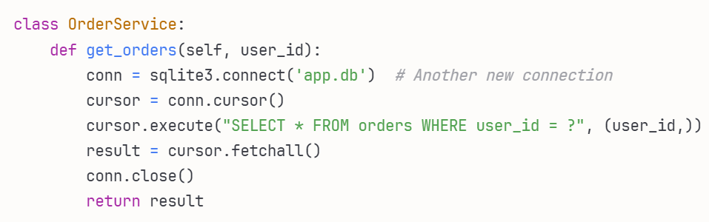
Basic approach - creating connections everywhere
6

Slide 7
Problems with basic approach
Multiple database connections are created unnecessarily
Database configuration is scattered throughout the code
Hard to change database settings
Potential connection leaks
Poor performance due to connection overhead

Slide 8
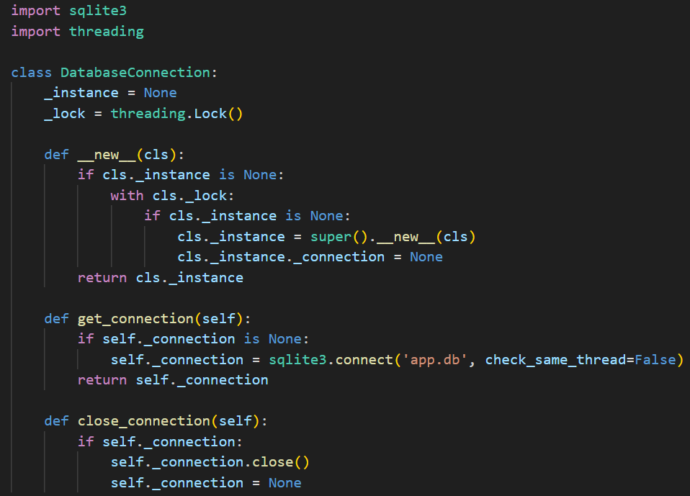
Solution: Using Singleton Pattern

Slide 9
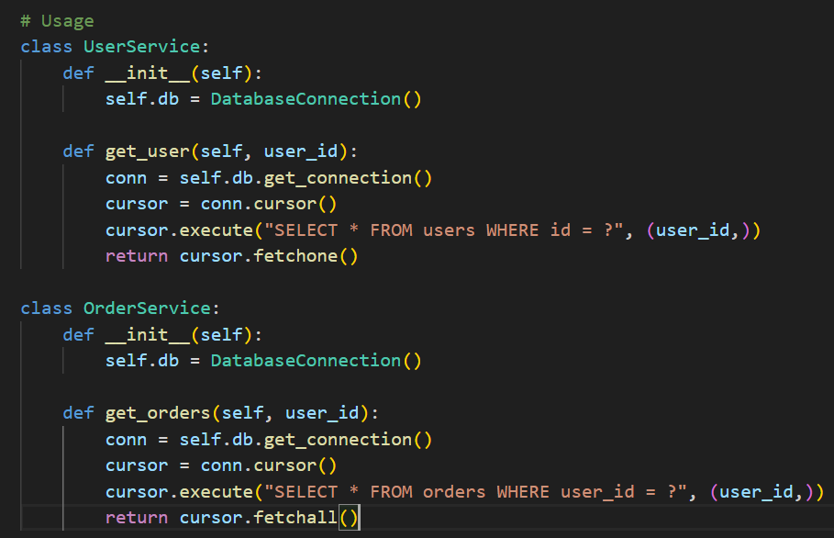
Continue…

Slide 10
Why Singleton pattern was necessary?
Resource Management: Ensures only one database connection exists
Performance: Avoids connection overhead
Consistency: All parts of the application use the same connection
Configuration: Single place to manage database settings
Thread Safety: Handles concurrent access properly

Slide 11
When NOT to use this pattern?
If you only make one or two database calls in your entire application
If you're using a database connection pool library that already manages connections
If your application is simple and doesn't have connection management issues
Summery: The key is recognizing when the complexity of implementing a pattern is justified by the problems it solves. In this case, the Singleton pattern transforms scattered, inefficient connection management into a clean, centralized solution.

Slide 12
2ed Practical Example
Practical Example:
  Payment Processing System

Slide 13
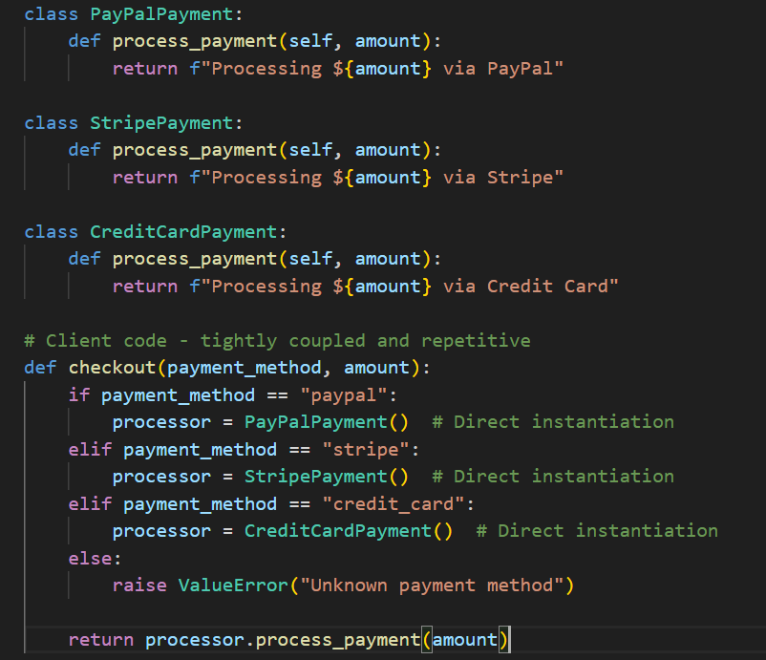
Basic Development
(Without Factory Pattern )
Notes:
Basic development: direct object creation everywhere

Slide 14
What are the problems?

Slide 15
Problems:
Every time you add a new payment method, you must modify the checkout function
Client code knows about all payment classes
Difficult to test and maintain

Slide 16
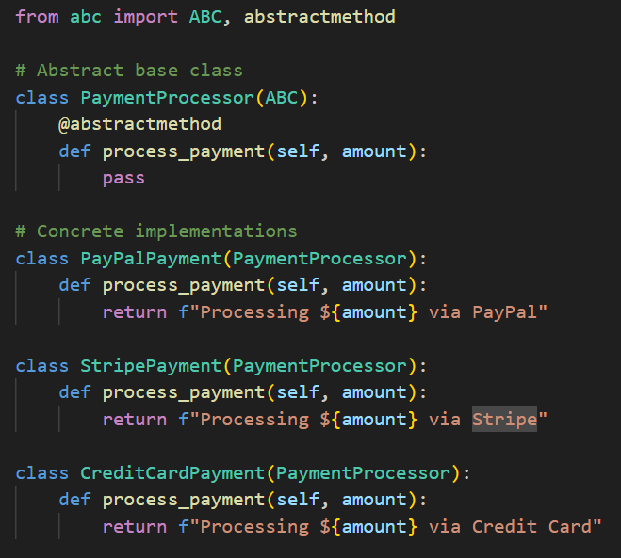
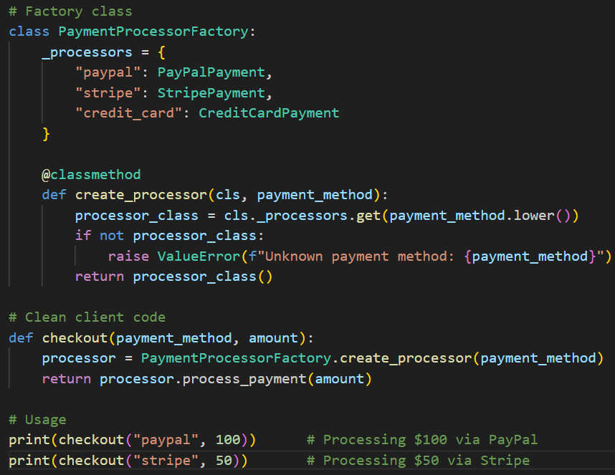
Solution: Factory Pattern

Slide 17
Benefits of Factory Pattern:
Easy Extension: Add new payment methods without changing existing code
Loose Coupling: Client doesn't know about specific payment classes
Single Responsibility: Factory handles object creation logic
Maintainable: Changes to payment methods are isolated

Slide 18
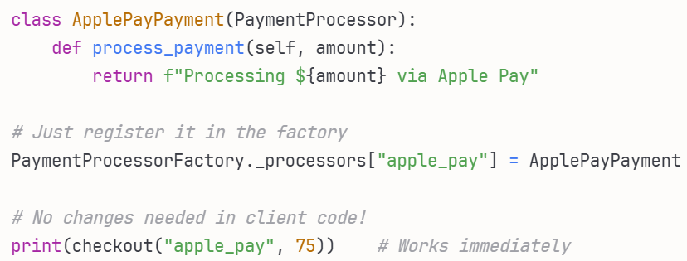
Adding a new payment method:

Slide 19
When NOT to use Factory Pattern?
If you only have 1-2 payment methods and no plans to expand
If object creation is simple and doesn't vary
If the complexity of the pattern exceeds the problem, it solves
Conclusion: The Factory Pattern is essential here because it transforms rigid, coupled object creation into a flexible, extensible system.

Slide 20
Q&A?

